Slide 1



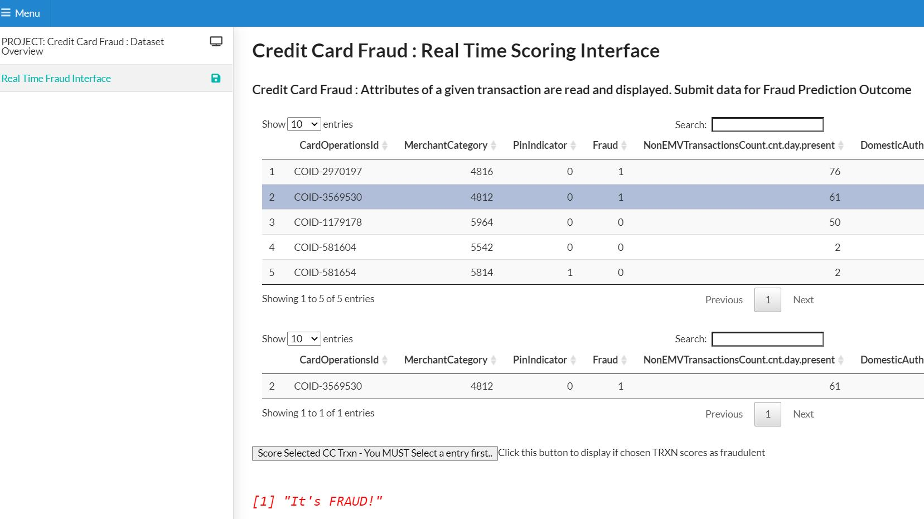
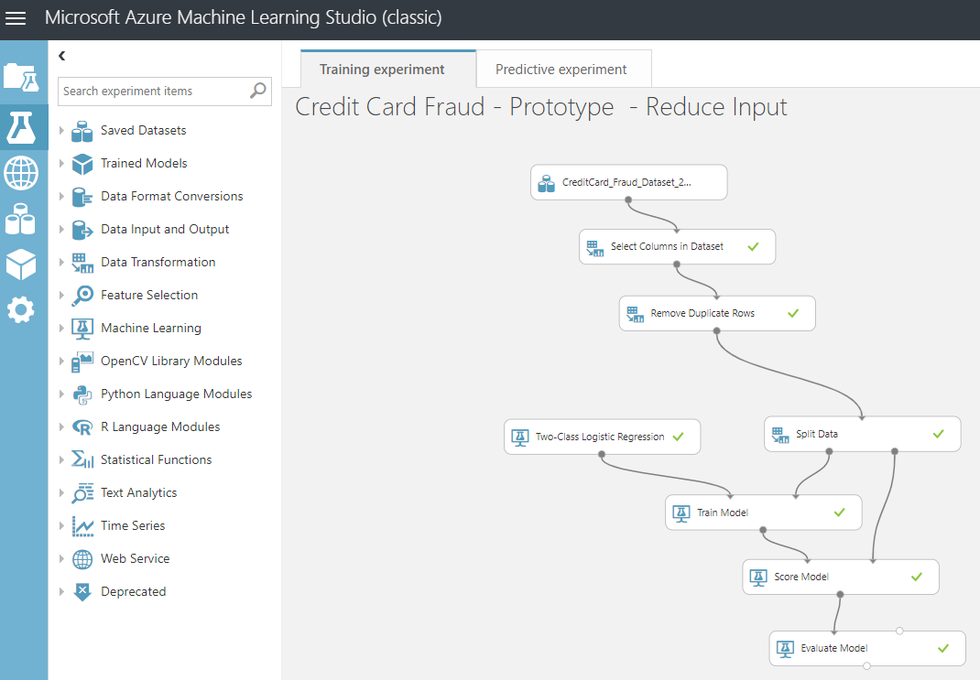


Credit Card Fraud Datasets
Credit Card Fraud Prediction Application
Azure Datastores
Hosted Shiny R App
Data : To Visualise + Check Model
Data : To Build Model
Machine Learning Studio (Classic)
Invoke Model – Return Class Score
Deploy Model

